Slide 1
Angular 2+
By Ben Pomerenke

Slide 2
What about Angular 1.X?
In 2014 google began a rewrite of Angular taking into account all the lessons learned from the original framework
Still supported
Requires more rigor on developer to keep code well organized (less opinionated)
Less tooling and community support now that Angular 2+ is out of beta

Slide 3
Working with Angular 2+
CLI support to get you started
Probably best to use Typescript out of the box (though it theoretically supports straight Javascript)
Requires Node.js for dependencies
Can use any editor of your choice, but I prefer Visual Studio Code
For source control, you will want to consider ignoring node packages (there’s a ton of tiny files and folders that will hose up git)
if you need more control over dependencies or just want to avoid needing outside internet access to build, consider standing up an npm server yourself)

Slide 4
Some things to know about the framework before you begin
Angular is very opinionated. There are well defined ways to do what you will need.
It is setup for automated testing out of the box. You should consider leveraging that to make your code more resilient to change / breaks.
When it’s time to deploy consider using WebPack to simplify the deployables and improve client side performance. The CLI will setup the basics and you may or may not need to tweak them along the way.
There are a number of 3rd party libraries built specifically to interact with Angular. You should try your best to use these over non-angular libraries whenever possible.

Slide 5
Project Structure
App Module
Dependency registration
Routing configuration / registration
Components
HTML / CSS
Backing “controller”
Services
Singleton
No presentation layer
3rd party libraries

Slide 6
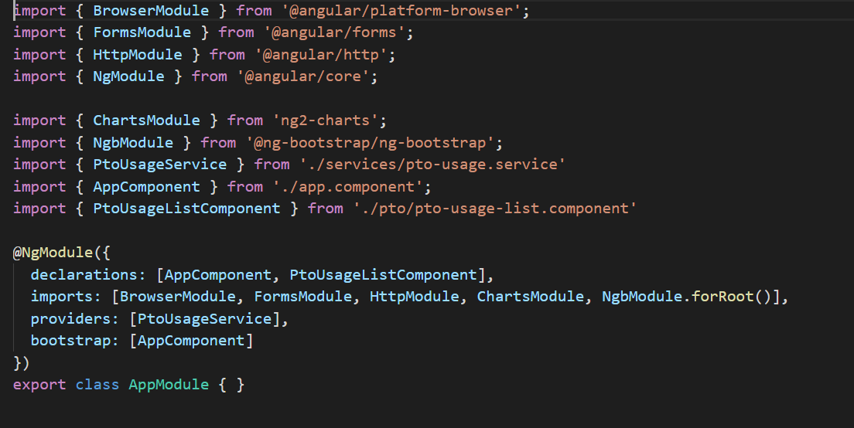
App Module

Slide 7
Components
Can be referenced in HTML via selector
Can have inputs and outputs from other components
Can have CSS and HTML inline in TS file or referencing separate files
Need to be paired with Services to retain state, communicate with other components, and interact with outside web services
Leverage 2 way binding to refresh data in the view

Slide 8
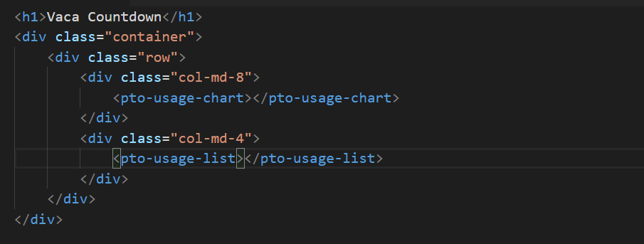
Component reference

Slide 9
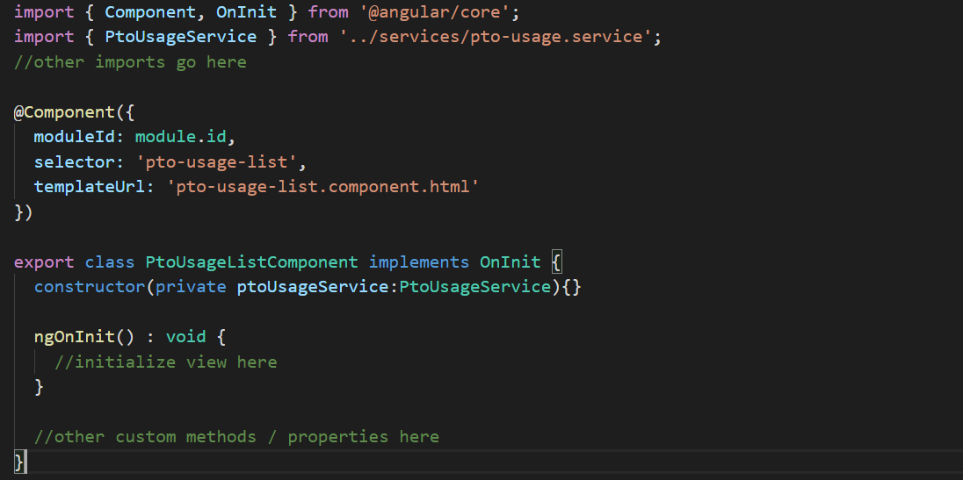
Basic Component

Slide 10
Services
Singleton (one instance per reload of page)
Usually used to communicate to backend web services
Allow common communication / interactions to be in a centralized location
Can be used to allow components to shuttle information between themselves (via Observables)

Slide 11
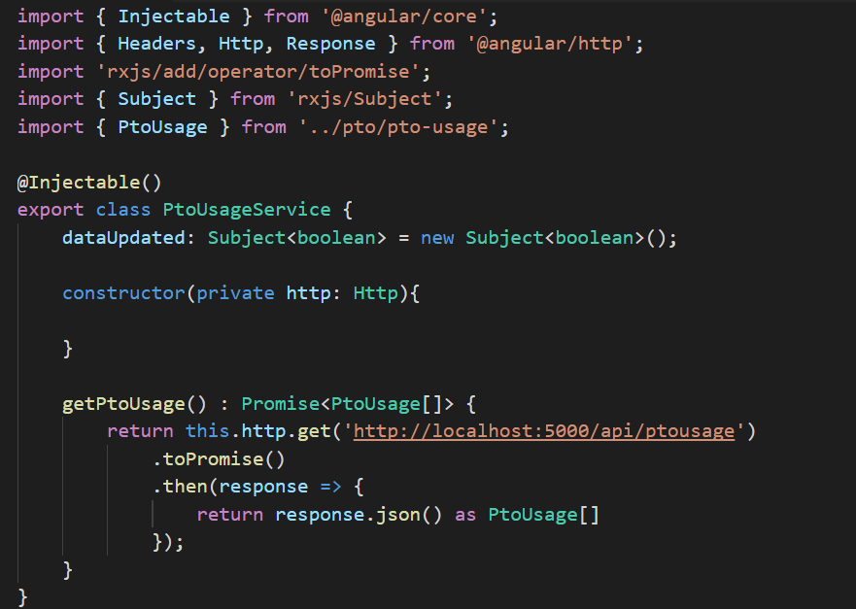
Basic Service

Slide 12
Simplified Expression Syntax
{{ }} for interpolation
[ ] for property binding
( ) for event binding
[( )] for two way binding for components
*ngFor for iterators
*ngIf for conditional display of HTML

Slide 13
Things not covered
Directives
Pipes
Guards
Modules
Unit tests
E2E tests

Slide 14
3rd party libraries
In this project
Ng Bootstrap
Port of bootstrap styled components for Angular
Ng Charts
Wrapper around Chart.js for angular
You can use 3rd party (non-angular) packages, however you have to be careful about their lifecycle

Slide 15
Code Demo
CLI
Data binding
Service
Component to component communication

